Slide 1
Identifying and Addressing Health Disparities
Gena Wilson, MD
ECRIP Fellow
Institute for Family Health
September 30, 2010

Slide 2
Source: U.S. Census Bureau, Population Division

Slide 3
National Healthcare Disparities Report 2009
“Disparities in Health and Health care persist in many areas”
Minorities in the U.S. do not receive the same quality of care as whites
Notes:
Infant mortality rates are higher for minorities.
Life expectancy is lower for minorities
76 years: Life expectancy for white males. 70 years: Life expectancy for African-American males.81 years: Life expectancy for white females. 77 years: Life expectancy for African-American females.

Slide 4
Notes:
Infant mortality rate is defined as the number of infants out of every 1,000 live births that die before reaching the age of one

Slide 5
Life Expectancy by Race, Gender

Slide 6
IFH Diabetics with Hba1c >9% June 2009 – June 2010

Slide 7
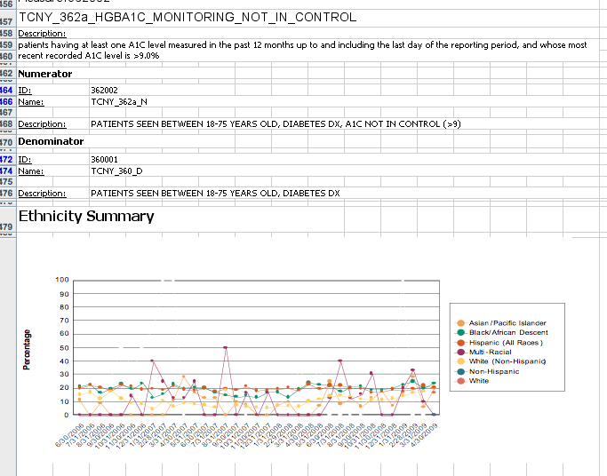
Notes:
Only 1 in 6 healthcare organizations who collect quality improvement data look at their own health disparities. When we begin collecting granular ethniciy, we will continue to run these reports but we will also have the capacity to look at granular ethinicity differences

Slide 8
Problems With Data
Not enough of it
Often not self-reported from patients
Why?
Staff felt uncomfortable asking
Staff felt they didn’t have time
Lack of training
Not Granular Enough

Slide 9
Current Meaningful Use Criteria on Demographic Data Collection
Stage 1 Criteria: Capturing patient health information:
Use EHR physician order entry system
Maintan up-to-date problem list
Record demographic info: language, insurance, gender, race, ethnicity, date of birth, death and cause of death
Capture smoking status
Incorporate data on clinical lab results

Slide 10
Race, Ethnicity, and Language Data: Standardization for Health Care Quality Improvement Institute of Medicine (IOM); August 2009
“A lack of standardization of categories for race, ethnicity, and language data has been suggested as one obstacle to achieving more widespread collection and utilization of these data. Many types of entities participate in initiatives to improve the quality of health care; health plans, hospitals, other providers, and health systems can and should obtain race, ethnicity, and language data so these data can be used to identify gaps and improve care for all individuals..”

Slide 11
Institute of Medicine’s Recommended Variables for Race, Ethnicity and Primary Language (2009)
Source: IOM Report: Race, Ethnicity, and Language Data: Standardization for Health Care Quality Improvement
t

Slide 12
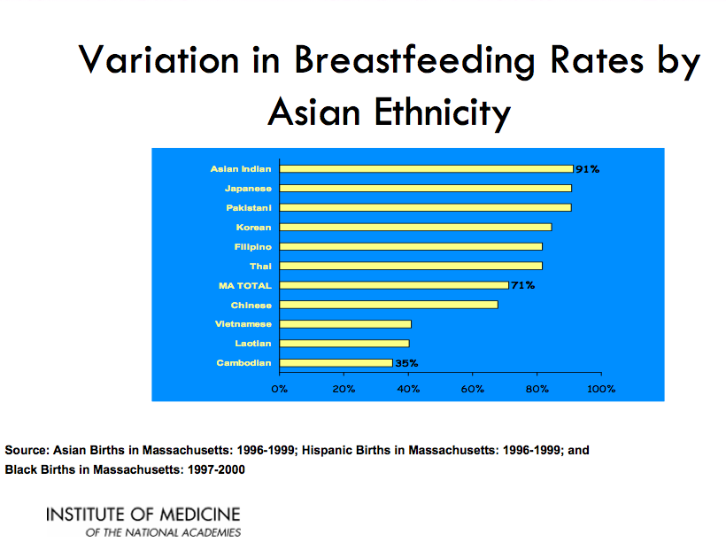
Notes:
This slide is fascinating! If we want to increase breastfeeding rates in Asian women, we first need to know which “Asian” women to target and why breastfeeding rates are so different for the different ethnicities.

Slide 13
Source: UCLA Center for Health Policy Research

Slide 14
Institute of Medicine Recommendations on Meaningful Use
Recommendation 6-1b:
HHS and the Office of the National Coordinator for Health Information Technology (ONC) should adopt as standards for including in electronic health records the variables of race, Hispanic ethnicity, granular ethnicity, and language need identified in this report.

Slide 15
Steps to Improve IFH Demographic Data Collection
Adopt Institute of Medicine recommendations
Improve all current fields on race, ethnicity language
Add new fields:
Interpreter need, Country of Birth, Granular Ethnicity
Training of all who collect demographic data using HRET Disparities toolkit: www.hretdisparities.org
Erase and recollect all new data

Slide 23
Current and Future Directions at IFH: Using HIT to Eliminate Disparities
MyChart in Spanish
MyChart patient entry of demographic data
HIV Registry stratified by race, ethnicity, language data
Demographic data on gender identity and sexual orientation
Hepatitis B Initiative: Based on Country of Birth – BPA plus inbasket message to provider

Slide 24
Summary:
1. Get Good Data
Quality Metrics
Race, Ethnicity, Language: As specific as possible – Use Institute of Medicine Report as a guide
Directly from the patient: requires staff training
2. Do the right thing with the data
Stratify quality metrics by race, ethnicity, language
Address Health disparities if you find them

Slide 25
“Knowing is not enough; we must apply. Willing is not enough; we must do.”— Goethe

Slide 26
Contact Info:
Gena Wilson, MD:
GWilson@institute2000.org

