Slide 1
Quality Reporting and Quality Improvement
Michelle Pichardo, MPH
September 30, 2010

Slide 2
Learning Objectives
How can electronic health record systems accelerate data collection for monitoring and improving quality?
Who are the key members that assist in monitoring quality data/reports and how is the information shared throughout the organization?
Now that your organization has access to data for quality reporting, how do you translate that into meaningful use?

Slide 3
HIE
EpicCare Link
Patient Portal
Quality Reporting/Improvement
Clinical Decision Support
Notes:
Over the past eight years the Institute has spent a great deal of time optimizing the use and functions of the EHR. Beginning with the successful implementation which included training multiple levels of end users and supporting day to day production of 15 health centers. The Institute has also been a leader in developing and implementing clinical decision support tools, prompts, and alerts as well as being able to report on many levels of patient outcomes. We are actively engaging our patients through our patient portal known as MyChart and currently have about 8000 active users. The Institute is also participating in several HIE projects including the NYC and NYS immunization registries; NYCLIX and Bronx RHIOs.
Health Information Technology enables Community Health Centers to interact with the Public Health System and become a vital part of that system.
The full integration of the EHR system presents unparalleled opportunities for data collection, monitoring, evaluation and quality improvement. The Institute’s information technology department has developed dozens of custom reports which permit the analysis of clinical, demographic, and visit data for specific subpopulations.

Slide 4
Goal of Quality Improvement
To reach the state of TQM (Total Quality Management).
Where all aspects of the organization are working towards improving quality.

Slide 5
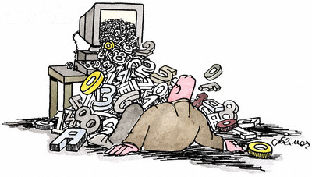
Get to Know Your Data

Slide 6
Build a Data Dictionary

Slide 7
Define All Key Elements Captured by the EHR
Patient Address
Race / Age / Gender
Medical history
Social history
Provider Location
Reason for visit
Problem list
Temperature
Blood pressure
Height/weight
Respirations
Procedures
Medications
Lab results
Diagnoses

Slide 8
Take the Time to QA the Data

Slide 9
Document and Define the Measures and Metrics
Identify the specific parameters.
Share with project team.
Review a test run of the report.
Decide how often the report with run.

Slide 10
A mountain full of data yet a finite amount of resources to handle it.
Target measures and target resources in the most efficient ways possible.

Slide 11
Quality Improvement Team
President & CEO – Neil Calman, MD
CIO - Weston Willett
CMIO - Joseph Lurio MD
Sr. Vice President – Robert Schiller, MD
VP Clinical Affairs- Nicole Nurse, RN
Quality Reporting Analyst - Kwame Kitson MD

Slide 12
Quality Reporting Examples
TCNY reports
UDS and IDS reporting
Diabetes and HIV disease registries
Risk stratification system
Site lead quality improvement initiatives

Slide 13
BMI Screening

Slide 14
Depression Screening
Notes:
the number of new patients (and new uninsured patients) served; and the number of visits provided to these new patients.

Slide 15
Colon Cancer Screening

Slide 16
Hypertension Control

Slide 17
Hypertension Control by Race¹
¹ UDS Measure, 2009
Notes:
Perform chart reviews if something does not seem correct to verify that the report is capturing what you have defined
Ask to have the report stratified by site, department, provider, etc or provider to obtain a deeper level of the information

Slide 18
Hypertension Control by Ethnicity

Slide 19
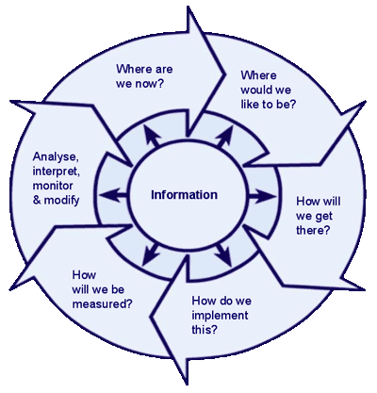
Disseminating the results

Slide 20
Other key points
Set reporting priorities
Participate in team member meetings
Maintain good documentation

Slide 21
Thank You
Contact Information:
Michelle Pichardo
Email: mpichardo@institute2000.org
Phone: 212-633-0800 ext.1279

