Slide 1
Diabetes Management and Meaningful Use
Elizabeth I. Molina Ortiz
Diabetes Medical Director
Institute for Family Health

Slide 2
Highlighted Stage I Goals
Implement clinical decision support rules
Generate list of patients by specific condition
Report ambulatory quality measures

Slide 3
Clinical Decision Tools
Requirements: support implementation of clinical decision support rules; generate real-time alerts based on those rules
One clinical decision support rule must be implemented

Slide 4
Example of Actionable Alert
A1c point of care → results available at start of visit
Annual comprehensive foot and sensory exam – monofilament completed during nursing intake

Slide 5
Great Improvement in completion, documentation and reporting

Slide 6
Diabetes Smartset
In one screen,
provider can:
Complete disease-specific documentation
Order labs
Send referrals
Choose diagnosis
Print patient instructions
Code LOS

Slide 7
Diabetes Registry
Requirement: generate lists of patients by specific conditions
Must be able to electronically select, sort, retrieve and output a list of patients and patients’ clinical information for at least one specific condition

Slide 8
Important first step towards monitoring care at population level
Versatile, vast amount of information
Basis for IFH Stats

Slide 9
Quality Measures
Requirement – support the calculation and display of quality measures

Slide 10
NCQA Diabetes Recognition Program Standards

Slide 11
Uncontrolled measures highlighted

Slide 12
Download, sort, select and identify patients for multiple types of targeted outreach

Slide 14
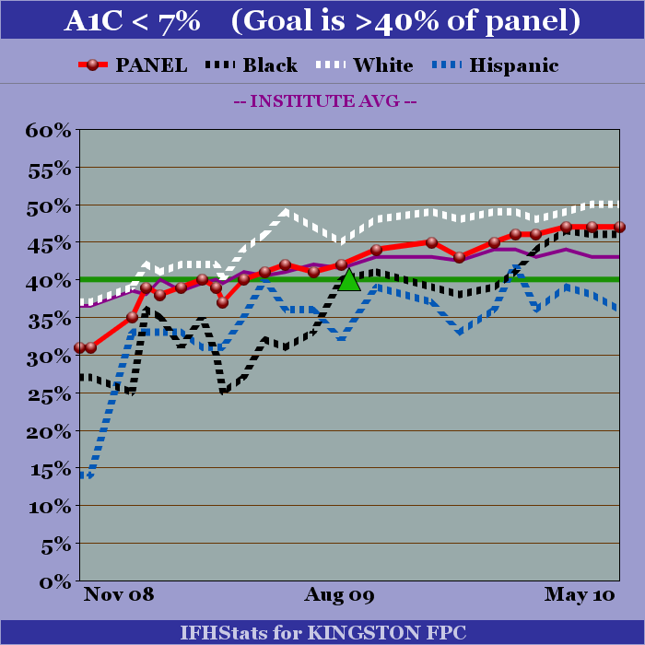
Track disparities; measure improvements

Slide 15
Recognitions
American Association of Diabetic Educators Accreditation
NCQA Diabetes Recognition Program:
E. 13th Street Family Health Center
Sidney / Phillips Family Health Center
Amsterdam Family Health Center
Mt Hope Family Health Center
Hyde Park Family Health Center

