Slide 1
Design and Use of Decision Support In a Primary Care Network
Joseph Lurio, M.D., F.A.A.F.P.
Chief Medical Information Officer
Institute for Family Health

Slide 2
Objectives Of Talk
Understand rationale behind decision support in era of electronic medical records and “Meaningful Use”
Learn principles of good decision support design

Slide 3
What is Decision Support?
“A decision support systems (DSS) is a computer-based information system that supports business or organizational decision-making activities”
http://en.wikipedia.org/wiki/Decision_support_system

Slide 4
Examples of Electronic Clinical Decision support
preventive service reminders,
alerts concerning possible drug interactions
clinical guideline-driven prompts
Key Capabilities of an Electronic Health Record System: Letter Report. National Academy of Sciences. http://www.nap.edu/catalog/10781.html

Slide 5
Non-Electronic Decision Support
Reference Texts
Article files
Handbooks
“peripheral brain”

Slide 6
Checklists and Forms (Prompts and Reminders)
Allow complex guidelines to be followed
Avoids errors of omission
Allows rapid documentation

Slide 7
Why Move to Electronic Decision Support?
Medical errors account for between 98,000¹ and 195,000² excess deaths per year
30 - 40% of patient care not meeting standards of medical evidence in US and Netherlands
Adoption of new standards by physicians takes in excess of 5 years.
1. IOM report 1999 2. AHCRQ 2004

Slide 8
Effects of Computerized Clinical Decision Support Systems on Practitioner Performance and Patient Outcomes. JAMA, 2005;293:1223-1238
CDSS Type | Number Studies | Number Demonstrating Improvement | % Studies Demonstrating Improvement
Diagnostic | 10 | 4 | 40%
Reminder | 21 | 16 | 76%
Disease Management | 37 | 23 | 62%
Drug Dose / Interaction | 29 | 19 | 66%

Slide 9
Automatic Vs Practitioner Activated Decision Support
CDSS Type | % Improved Provider Performance
Automatic | 73%
Provider Activated | 47%
Effects of Computerized Clinical Decision Support Systems on Practitioner Performance and Patient Outcomes. JAMA, 2005;293:1223-1238

Slide 10
What Does Successful Computerized Decision Support Look Like?

Slide 11
Driving home on a rainy night a man notices a small amber light has appeared on the dash. At the next exit, he pulls over, finds a gas station and fills the tank
Intervention unobtrusive
Amber light chosen for visibility
Driver understood alert without having to consult owners manual
Light came on while there was still time to find gas.

Slide 12
What the low gas alert didn’t do…
Stop the car from running till gas was added
Try and teach the driver something new
Try and convince the driver to do something with which s/he disagreed

Slide 13
Clinical Decision Support Performance Standards
Non-intrusive
Highly visible
Soft stopped
Fast
Simple
Presented “just in time”
Actionable (linked to or containing order sets)
Supported by best evidence, local consensus, payer incentives and rapid-cycle feedback

Slide 14
Soft Stopped
A “soft stopped” alert can be over-ridden by the provider, either by clicking on a button, or by entering explanatory information
“Hard Stops” must be attended to before care can be completed.

Slide 15
Fast (Never discount time pressure!)
Reduce # of screens
Reduce clicks
Default to the most common selections
Short Abbreviated CDS messages

Slide 16
K.I.S.S.
The more complex the tool, the less it will be used.

Slide 17
Just in Time: Intrusive reminders must be presented when they are needed
Alerts presented before review of orienting information will be ignored.
Alerts presented after therapeutic plan determined will be ignored

Slide 18
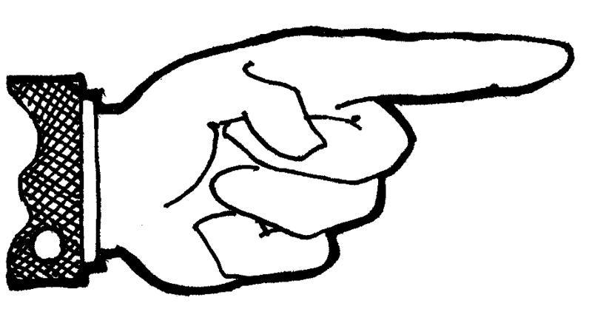
Actionable

Slide 19
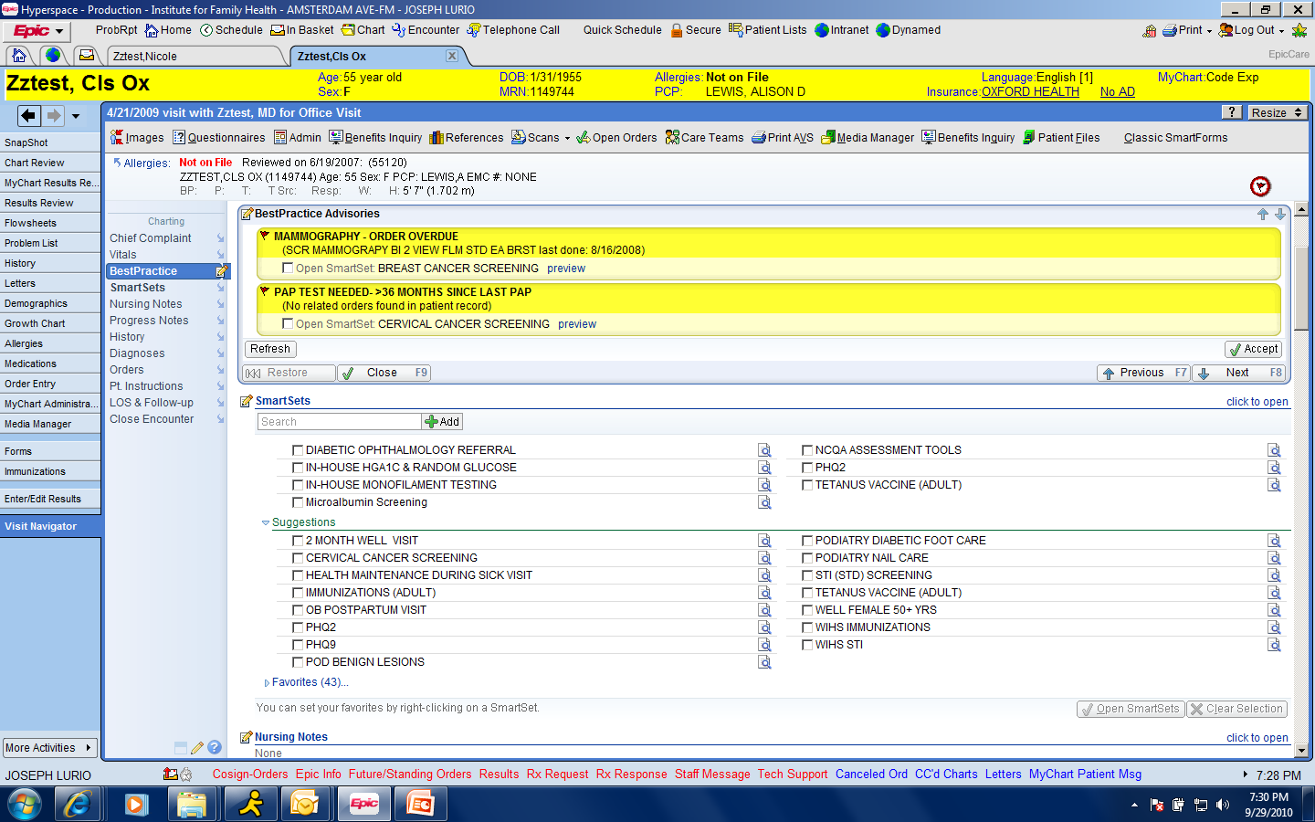
Simple Alerts

Slide 20
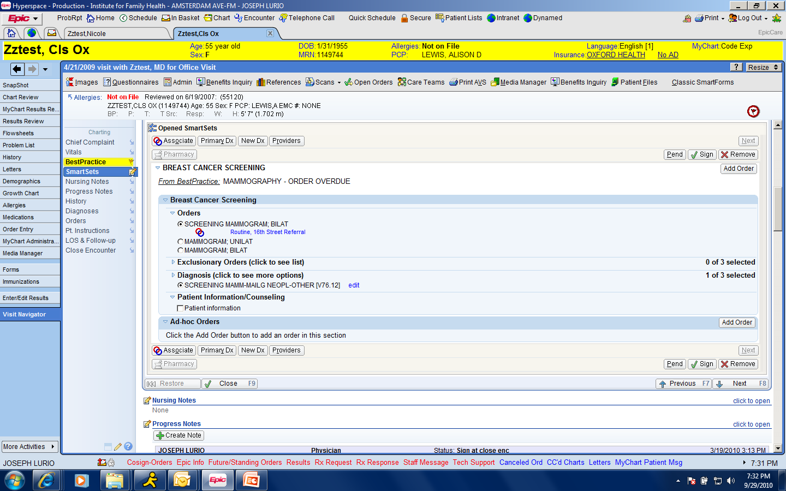

Slide 21
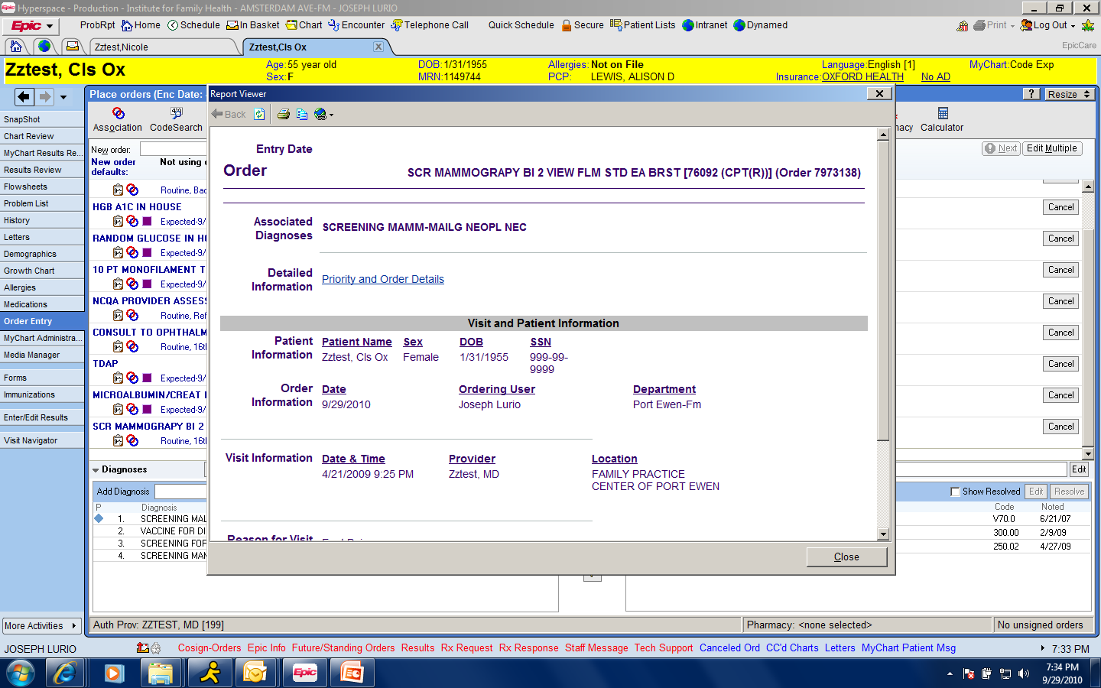

Slide 22
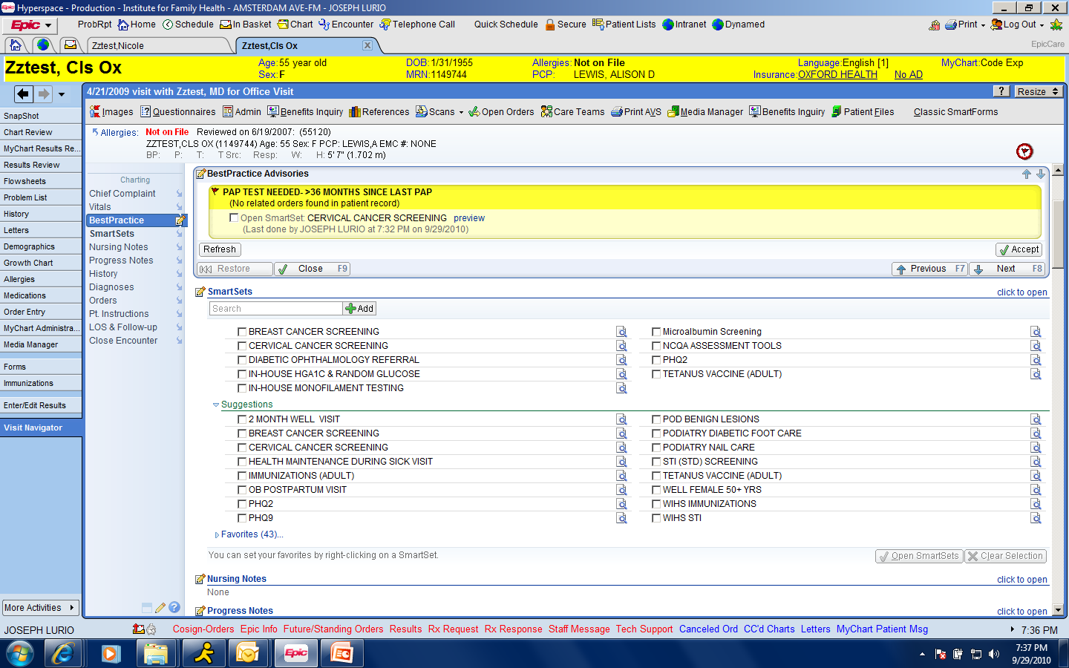

Slide 23
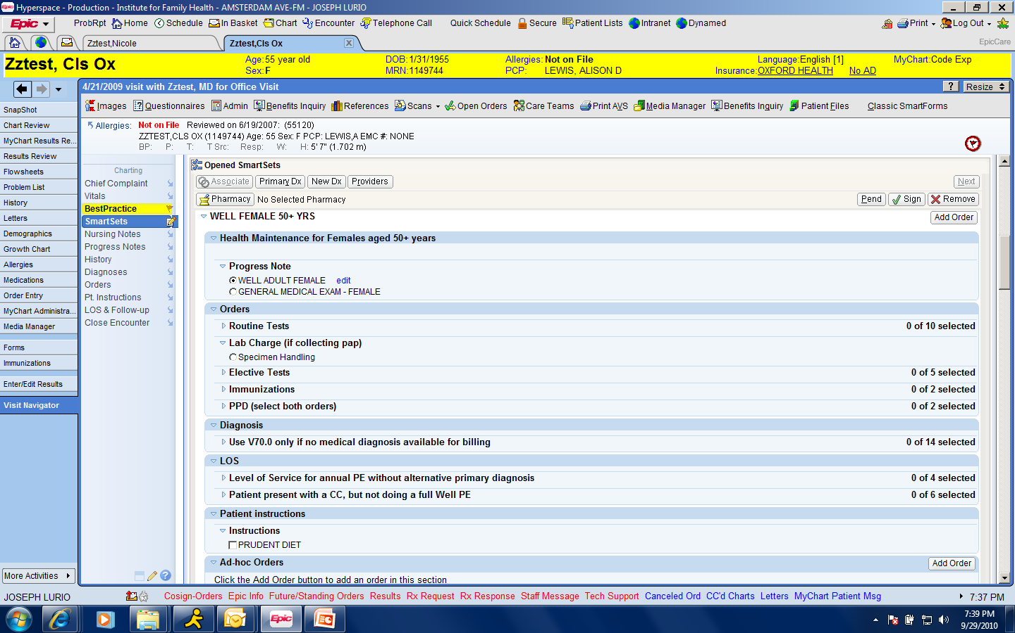

Slide 24
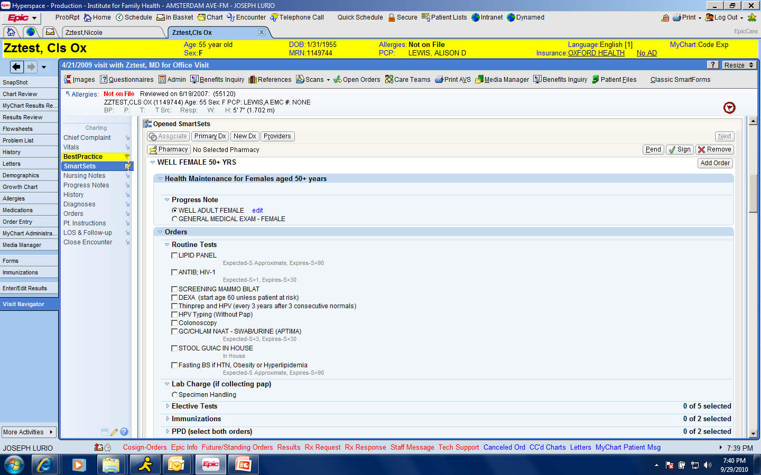

Slide 25
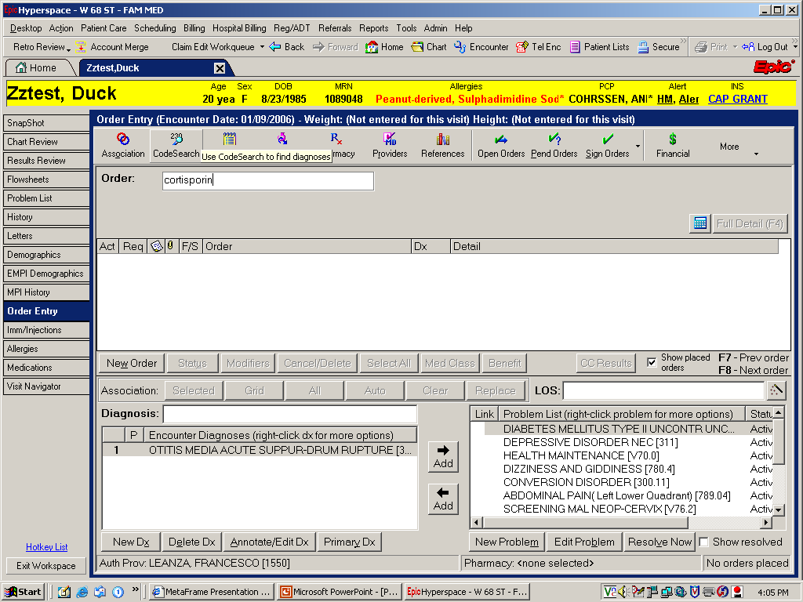

Slide 26
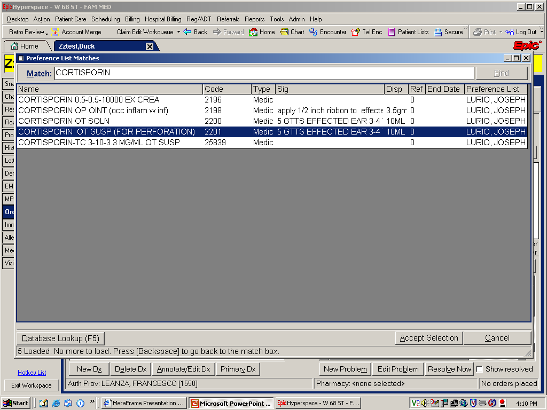

Slide 27
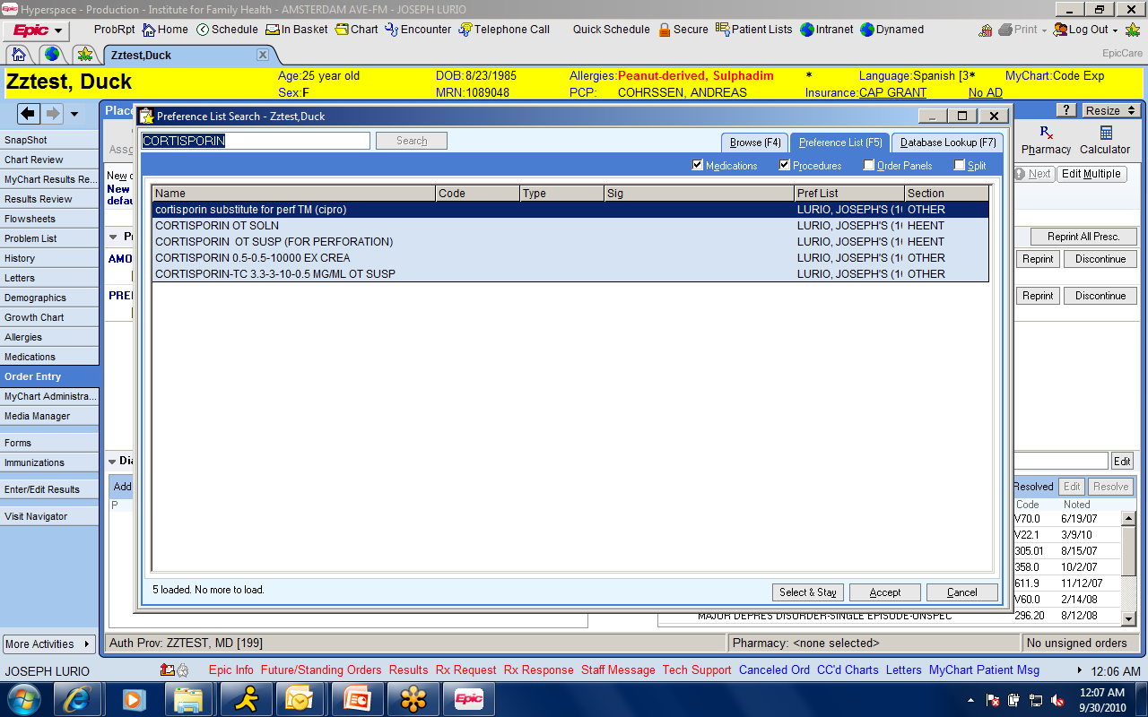
Alternatives: evolving with time

Slide 28
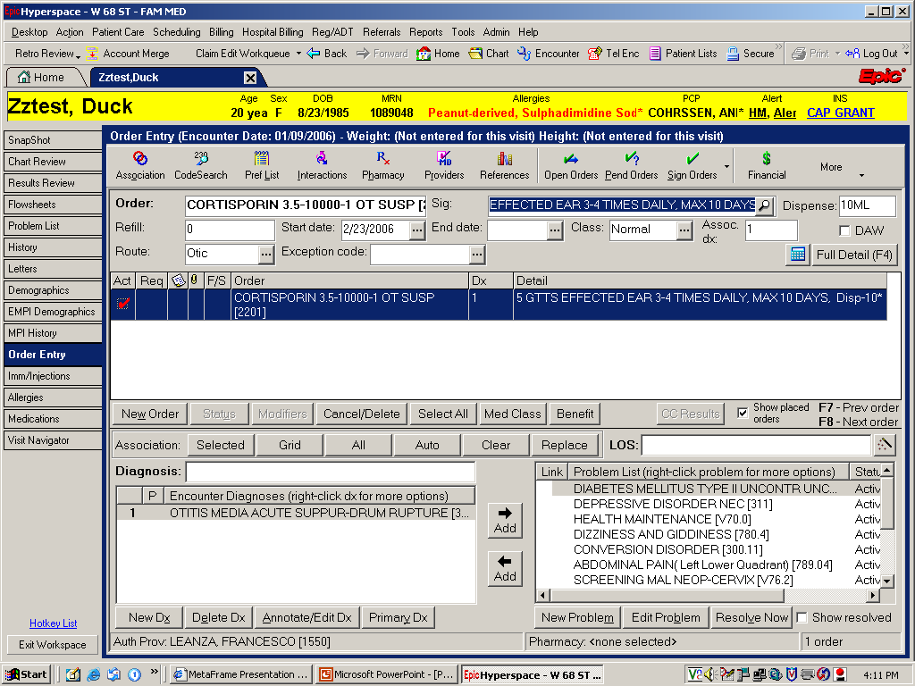

Slide 29
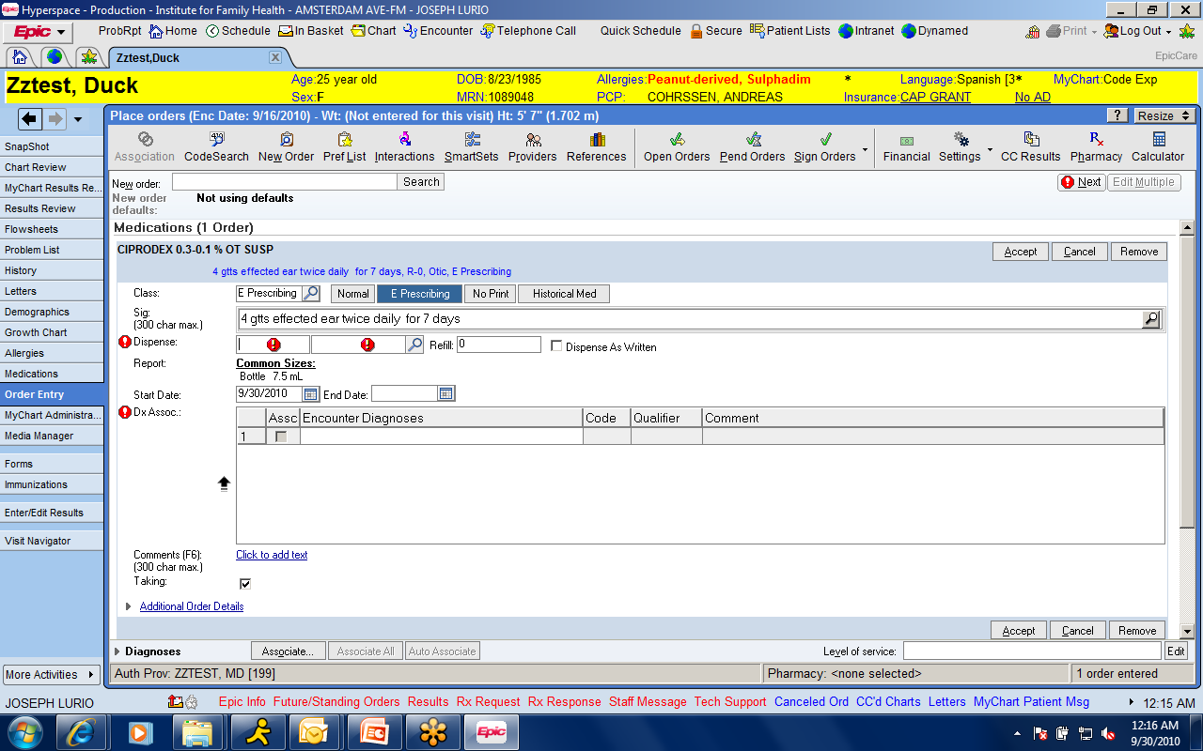

Slide 30
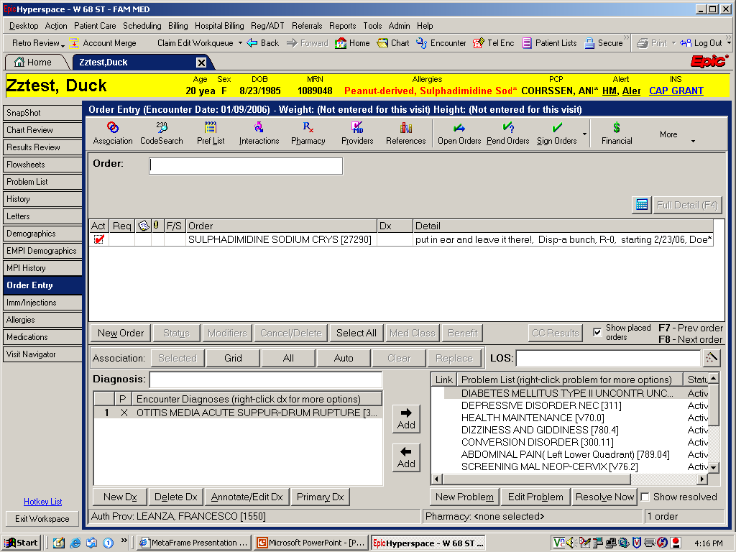

Slide 31
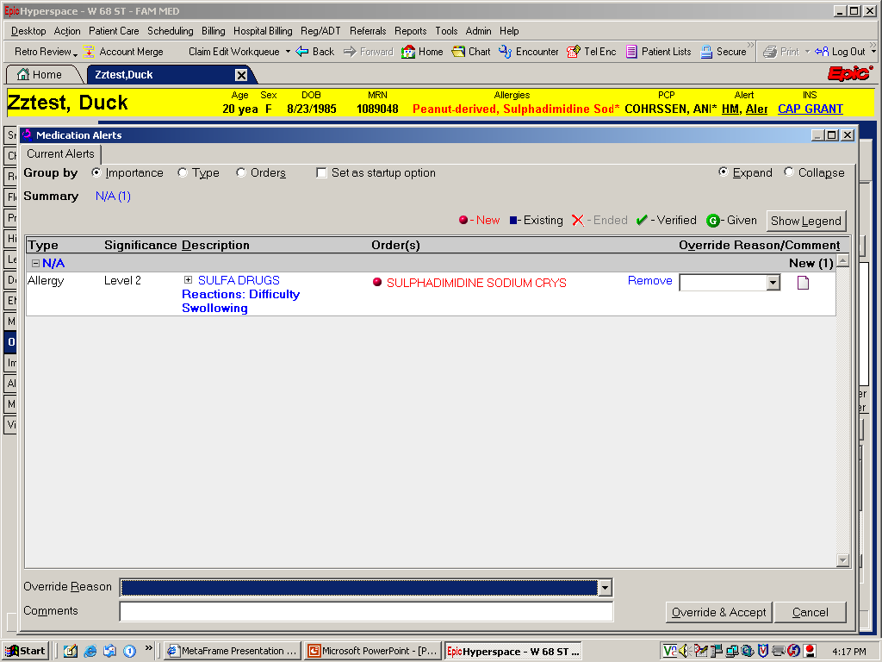

Slide 32
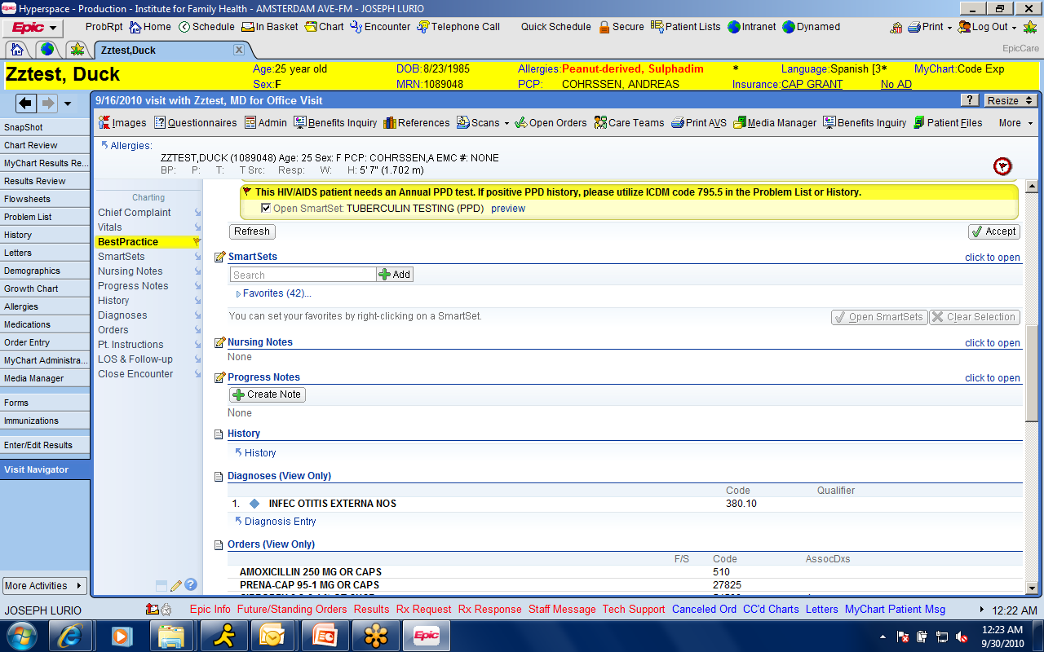
“not indicated” procedure to turn off alerts

Slide 33
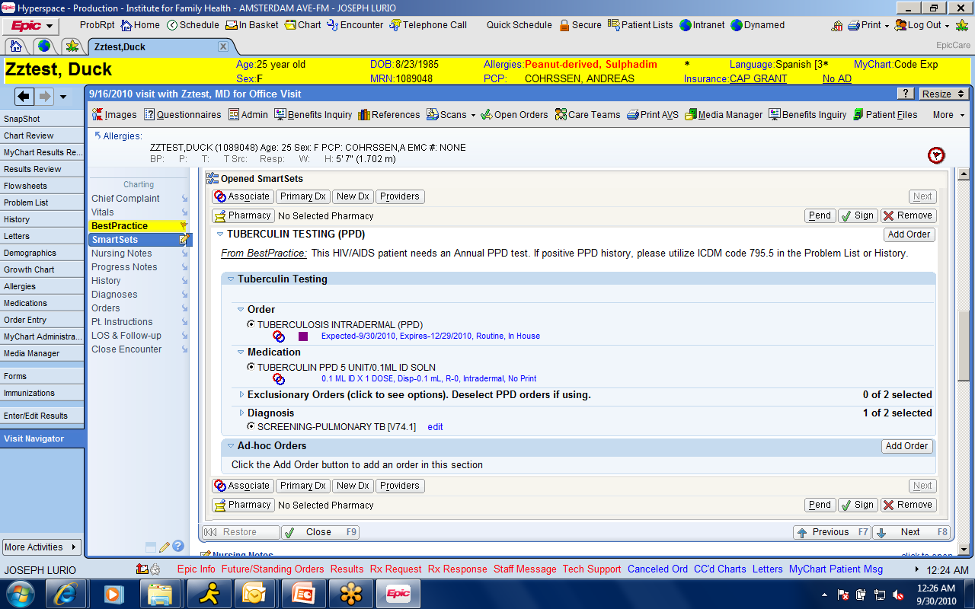

Slide 34
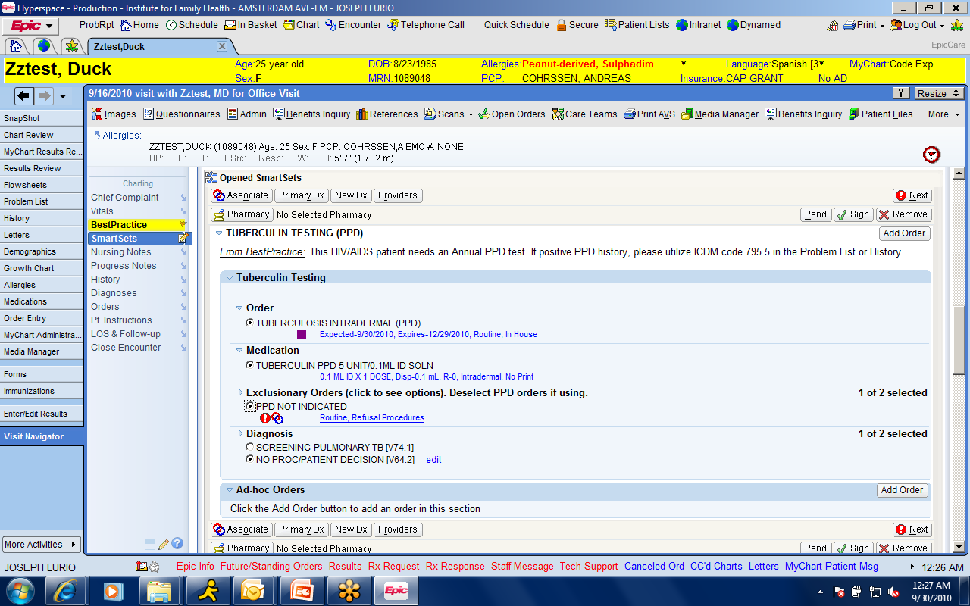

Slide 35
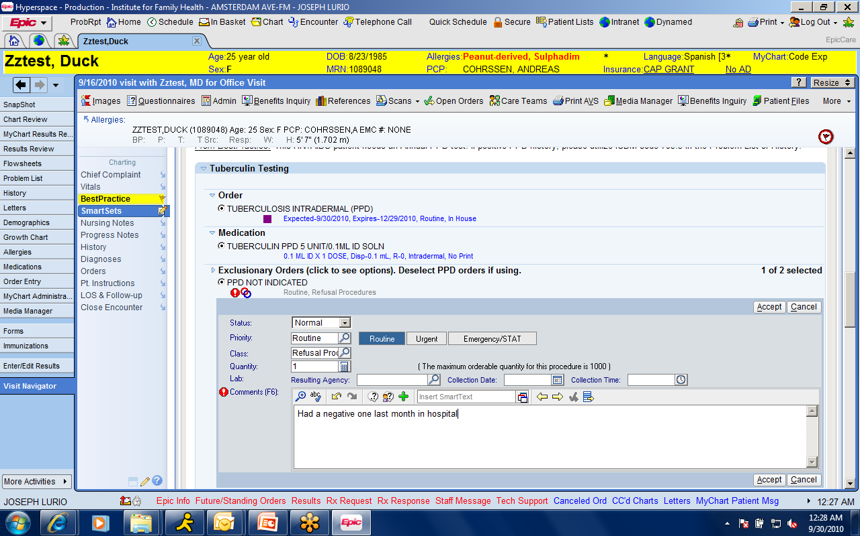

Slide 36
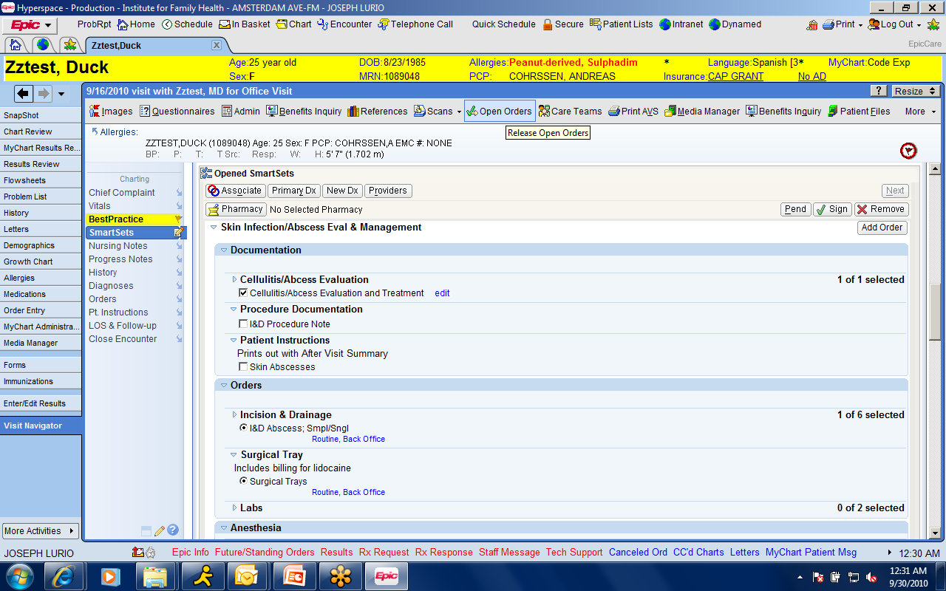

Slide 37
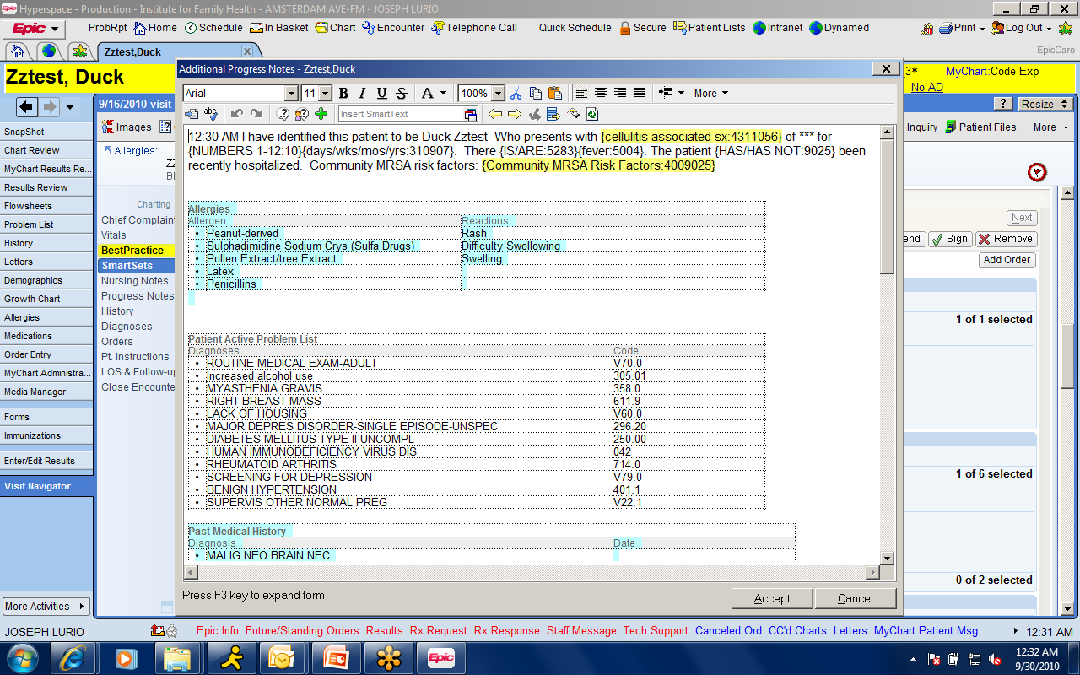

Slide 38
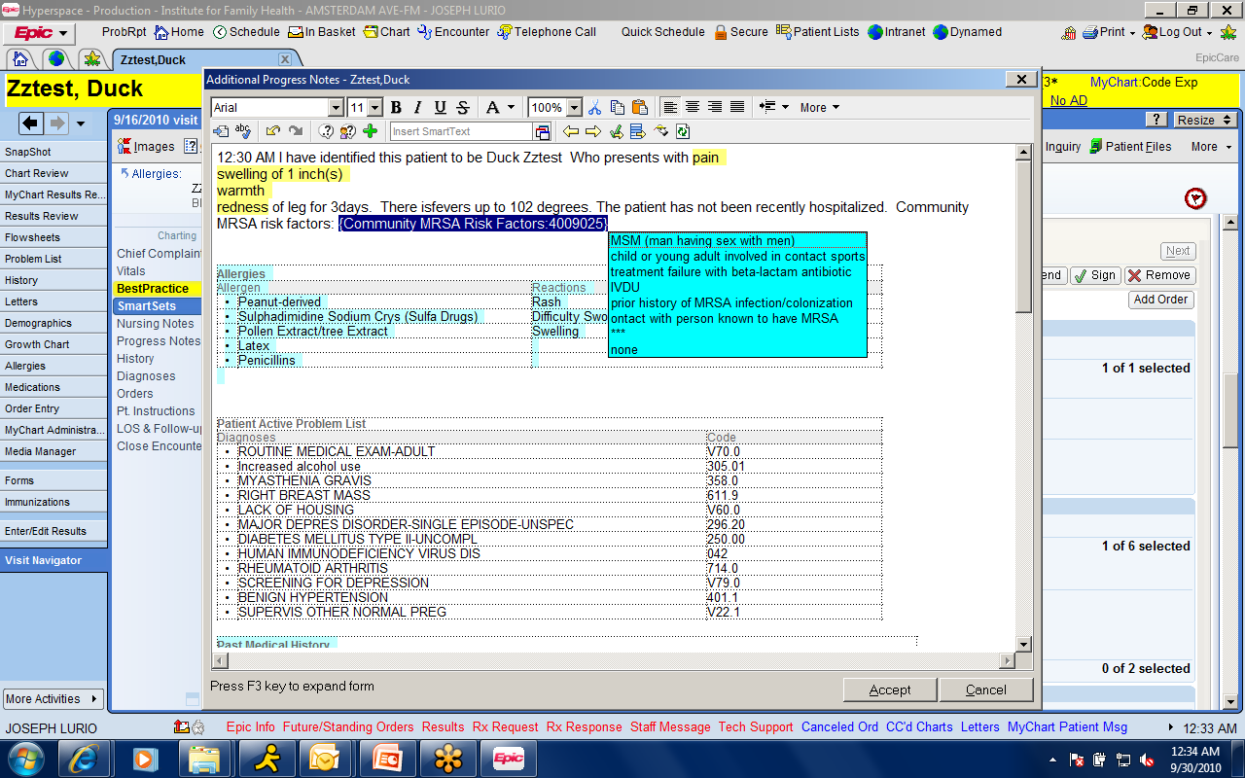

Slide 39
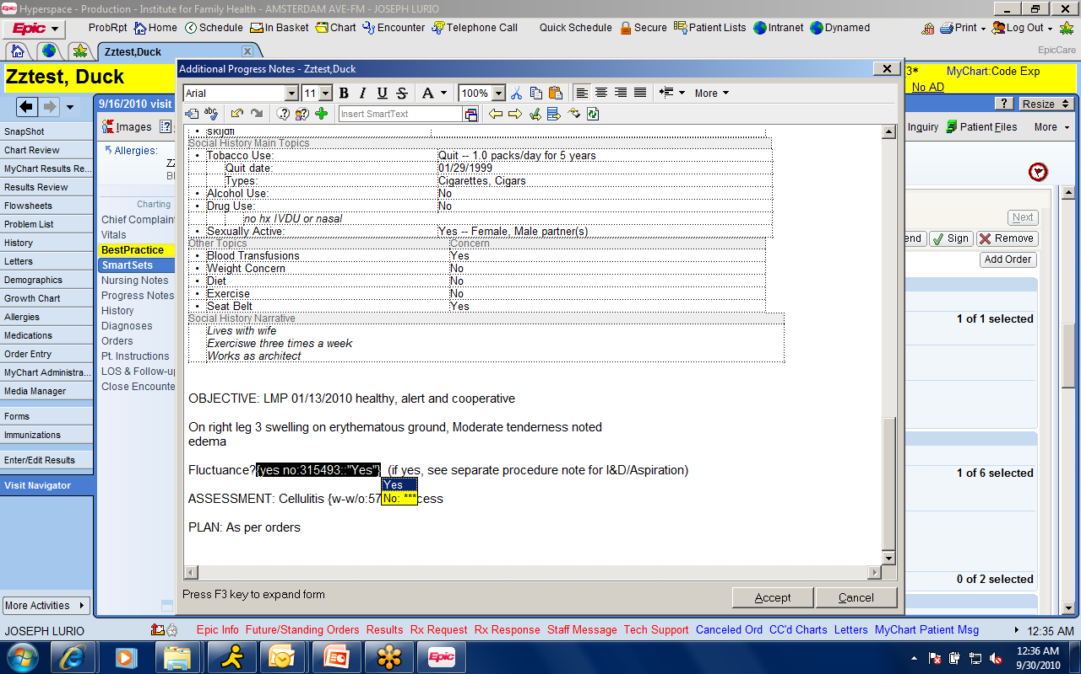

Slide 40
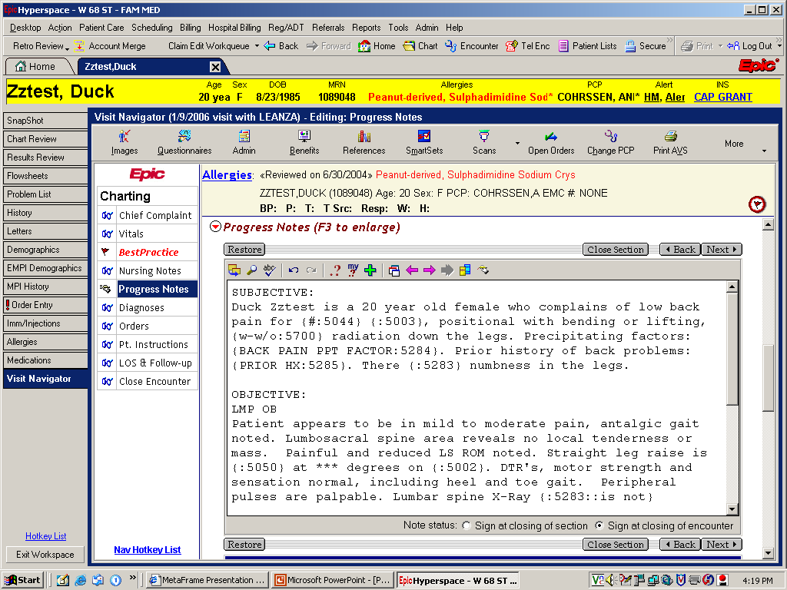

Slide 41
Diabetes Smartset
Facilitate Documentation
Prompts appropriate evaluations
Medication adherence
Diet and Self monitoring adherence
Foot exams and filament testing
Facilitates Orders
Facilitates Patient Education/Contracting

Slide 42
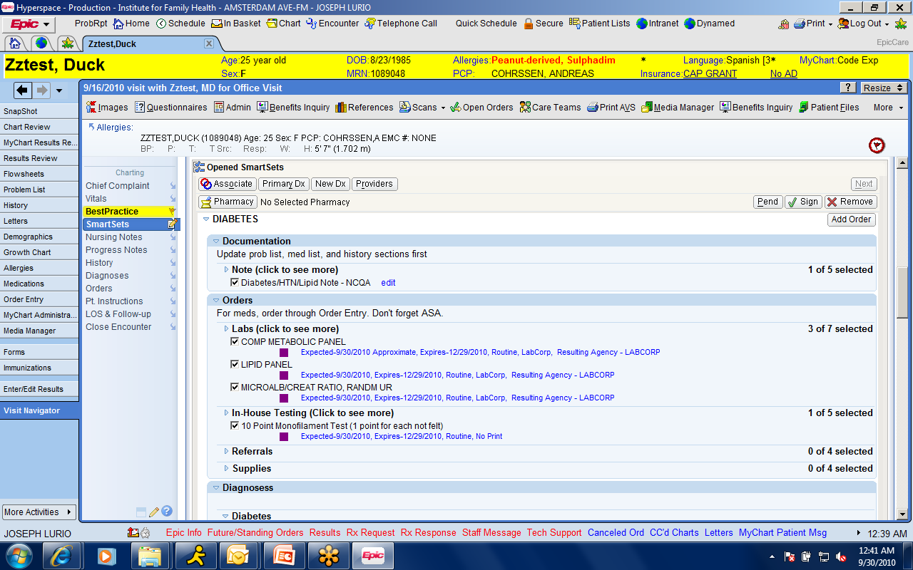

Slide 43
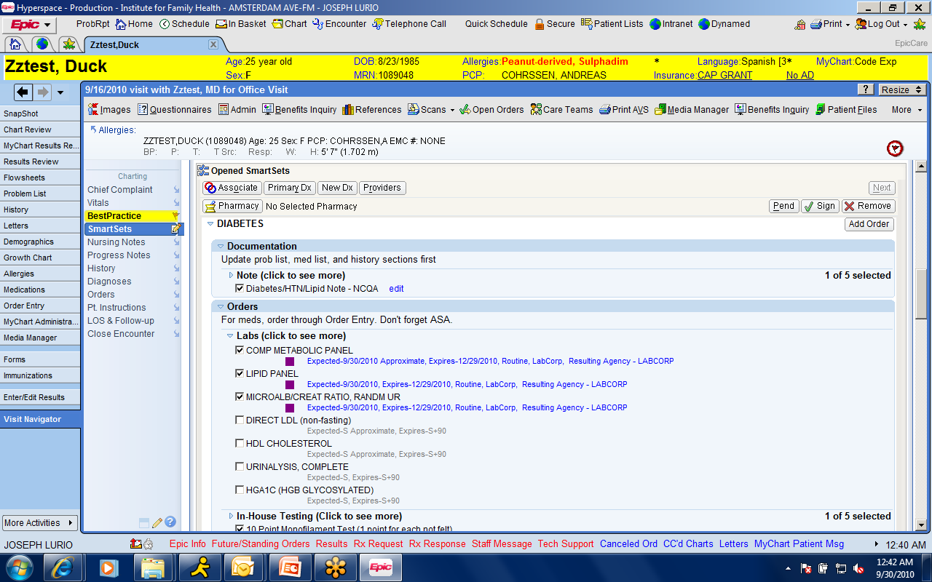

Slide 44
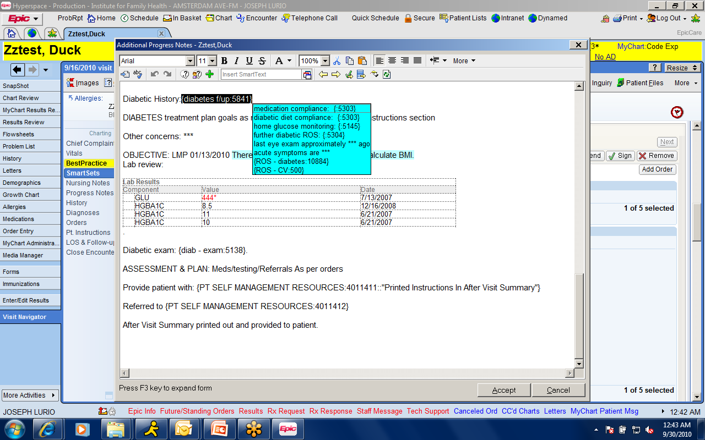

Slide 45
In Summary: Clinical Decision Support
Integrates reference data directly into Clinical Workflow
Checks for omissions and missed opportunities
Can stop the clinical process before an error is made

Slide 46
The physician’s Relationship with reference material changes
From reactive, searching for answers to questions arising from clinical changes
To proactive, planning optimal responses to anticipated situations
Electronic medical records allow efficient utilization of evidence based protocols without losing flexibility necessary in medicine.

